Slide 1
USCG Behavioral Health: Mental Health MythBusters!
HSC Jordan Suchon - Senior Behavioral Health Technician, LANT AOR
LT Jamie Williams, BSN, RN –Regional Nurse Case Manager D11/D14
LT Katie Torsella, MPAS, PA-C, CAQ-Psych – D17 Kodiak
LT Curtis Hagerman, LCSW – Regional Behavioral Health Provider D7 Lower Half
CDR Sherry Gracey, PsyD – Regional Behavioral Health Provider D14
Wellness Wednesday - May 17, 2023

Slide 2
Behavioral Health in CG - Agenda
What does it look like?
Past, present, and future state
The stigma
Medical Team
Unit integration and support
Working towards creating behavioral-health-minded units
END GOAL: Shift the paradigm to destigmatize behavioral health, thereby enhancing mission readiness and safety

Slide 3
BH Mission
New program started DEC2020
Regional BH Provider/Officer (RBHP) (currently 11/13)
BH Nurse Case Managers FEB2022 (currently 5)
BH Technicians ongoing; (currently 6)
Direct patient care (focused on fitness for duty, high risk, suitability for duty, MEB, complex case consultation) most psychotherapy referred to the network
High risk case management
Prevention/training: reduce stigma early intervention is key
Notes:
Average wait time to see a provider: 17.5 days for MTF/Tricare, <7 days for embedded (in-house) services (CG BH)
Operational knowledge, evidence-based treatment

Slide 4
The Team
Who provides MEDICAL BH care?
HSs
Health Services Technicians (first line)
IDHSs
Independent Health Services Technicians (first line)
Nurse Case Managers
Manage and facilitate care
Behavioral Health Technicians (BHT):
HS who have advanced BH training
Medical Officer / (PCM)
Physician Assistant or Doctor
Behavioral
Health Providers
CG Psychiatrists/Regional Behavioral Health Providers, MTF/Tricare providers
Notes:
R. 20 min next 3 slides

Slide 5
Small But Mighty
What do we do?
Direct Patient Care: Fitness for duty, medical boards, evaluations, on-going care
Consultation and engagement with Command, leadership and unit
Behavioral Health training
Complex case management
Collaborate with medical care team

Slide 6
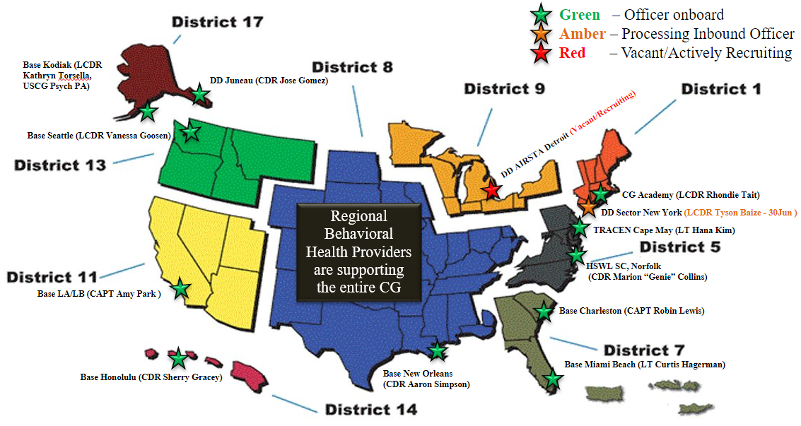
Regional Behavioral Health Providers (RBHP)

Slide 7
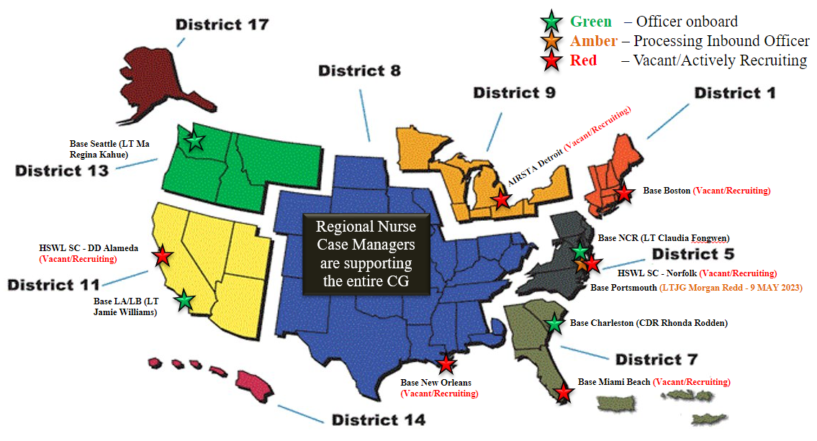
Regional Nurse Case Managers (NCM)

Slide 8
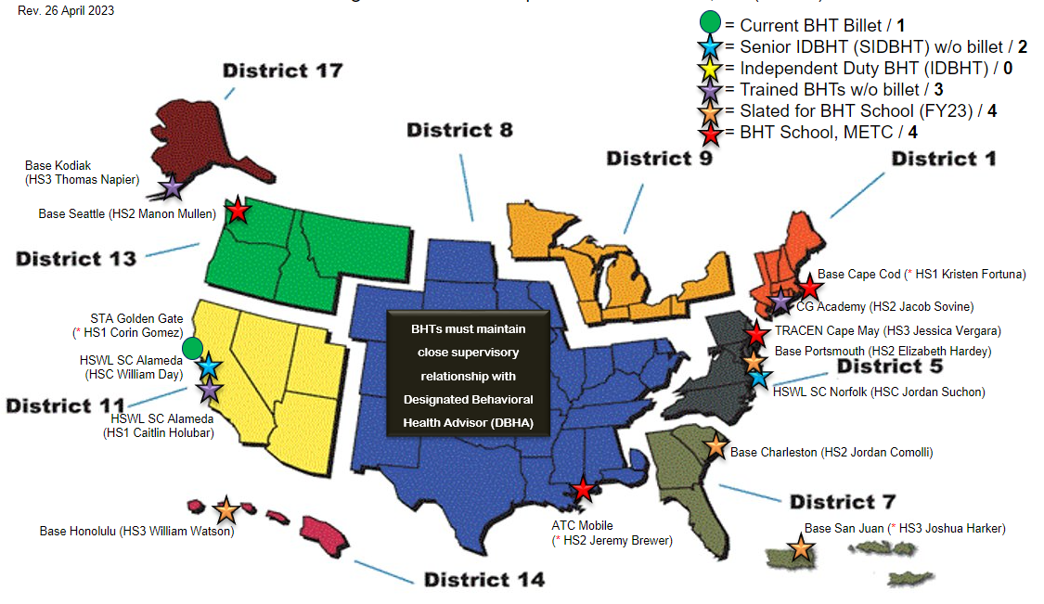
Behavioral Health Technicians (BHT)

Slide 9
BH 101

Slide 10
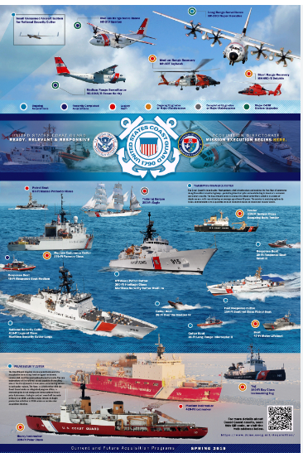
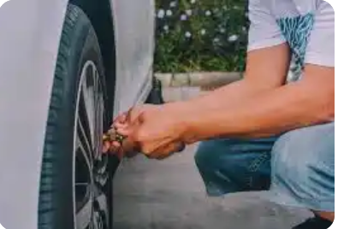
What do we currently maintain?

Slide 12
Stress Is Normal

Slide 13
Breaking down the barriers
Barriers to help seeking:
Need to do more with less
If you say something, your career is over
Do not want to be seen as “Broken” or “Lazy” (names or perceptions we think others will have of us)
If I do not ___, then someone else needs to do more because of me
Goals to promote:
Mental wellness helps to optimize performance
I don’t have to wait until I’m injured or ill to get additional training/support
I need to take care of ____ so that I AM able to stay in the fight
Increasing awareness, insight, and skills is OKAY and encouraged
Working together to create a healthier and long lasting force

Slide 14
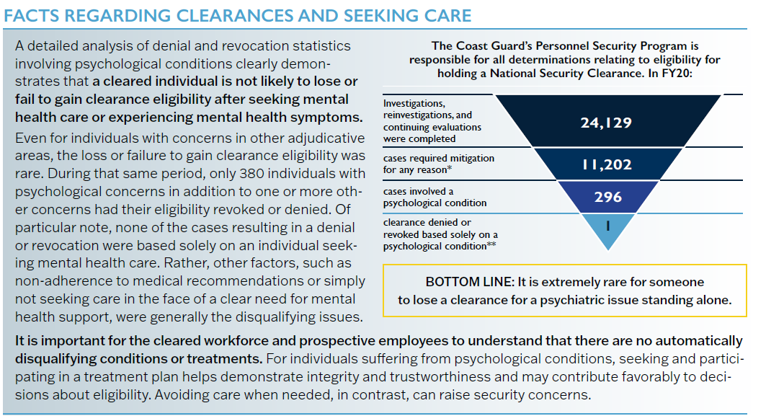
Myth #1: My security clearance will be automatically revoked!

Slide 15
Myth #2: Disposition
If I seek mental health services, this is what automatically happens….
My career is over.
I’m going to get kicked out.
I will not be able to do my job anymore
I’ll be in treatment FOREVER!
I cannot take medications and remain in.
I’ll ask my provider for a medical board
Seeking behavioral health/mental health treatment can look different based on the individual’s needs.
Treatment plan is developed with your provider with specific goals to reach, discuss with your provider goals and how you are working together to reach those goals.
There are medications that are approved to be utilized within the CG, if you are being treated with medications by a provider outside of CG medical, please be sure to notify your CG medical clinic of the medications. There may be some initial limitations when starting a medication as the provider wants to ensure there are no side-effects, but please be open with your medical team so they can best provide care.
The CG medical provider are the providers that make recommendations such as limitations of duty and medical boards. If you see someone outside of CG medical, and they make duty limitation recommendations to you, it is important that the information goes to CG medical clinic to be informed and confirmed.

Slide 16
Emergency/crisis – 911, ER, crisis hotline ; Not sure what is needed? Contact Work-life or medical to help figure it the best first step.
Resource | Services | How to activate | Confidentiality? | Medical Record? | Additional Info:
CGSUPRT | Non-medical counseling Training Beyond BH | 855-CG-SUPRT (247-8778) www.CGSUPRT.com | Mandated Reporter | No | 12 sessions
Work-Life | Training Work-life stress Skill building CISM, suicide prevention Finances |  | Mandated Reporter | No | Assist with other work-life resources
Chaplain | Care and support regardless of religious beliefs |  | Ultimate confidentiality – YOU hold the key | No
Tricare Network | Individual, marital, family Different levels of care depending on need. | If Active Duty, a referral is REQUIRED Contact your medical clinic for assistance | Mandated Reporter | Quarterly progress reports are sent in to include in record | In-person or virtual, # of sessions depend on clinical need
Military provider (e.g., Army/Navy/Air Force) | Individual, marital, family Different levels of care depending on need. | If Active Duty, a referral is REQUIRED Contact your medical clinic for assistance | Mandated Reporter Additional limitations include duty and service related fitness and mission related impact. | Yes | Only during regular MTF duty hours
CG Regional BHO | Consultation Training Evaluation Treatment | PCM HS triage Contact medical clinic | Mandated Reporter Additional limitations include duty and service related fitness and mission related impact. | Yes | Only for active duty Individual only Collaboration with CG medical team Limited availability

Slide 17
Additional resources
Total Force Awareness Self-Survey
This short evaluation provides you an awareness of how well you may be doing in ten different areas of your life.
Tricare Advice Line: 24/7 health advice from registered nurse
Vet Center: contact local Center – If active duty: focus is trauma
Suicide Crisis Hotline, lifeline chat: 988; https://988lifeline.org
In-Transition: a bridge to support between health care providers if transferring or separating from service
Safe Helpline: https://www.safehelpline.org/index

Slide 19
What Can I Do?
1) Self-assessment. How is YOUR foundation? Be the role model. Know where you can shore up.
Incorporate behavioral health (human factors and performance optimization) as part of regular ongoing
discussion.
3) Reintegration. Think about a return to work process, its good we all have one regardless of circumstance.
4) Give Hope.
Consult, consult, consult. We are always willing to talk. We can discuss or set you in the right direction to the
right resource.
Integration and Engagement. Everyone comes with different background and training. Invite us out. Work
out a schedule and get a good rhythm.
Connection is critical. Have people connect. People are lonely, away from family/friends. Support morale
events to break out of the day-to-day routine. GET TO KNOW YOUR EACH OTHER.

Slide 20
Available trainings
Reach out to the Behavioral Health Team and request to connect with your District Regional Behavioral Health Provider.
Behavioralhealth@uscg.mil
Start the conversation
Genuinely ask each other “How are you doing?”
Be aware of what is someone’s “norm” and when they deviate
Think about how your foundation is and what is needed.

Slide 21
BH CONTACTS
Regional Behavioral Health Providers
CDR Vanessa Goosen – Seattle, WA (DIST13)
CDR Sherry Gracey – Honolulu, HI (DIST14)
CAPT Robin Lewis – Charleston, SC (DIST7 North)
CDR Gina Ligonde – Cleveland, OH (DIST9)
LT Hana Kim – Cape May, NJ (TCCM)
LT Curtis Hagerman – Miami Beach, FL (DIST7 South)
CAPT Amy Park – Long Beach, CA (DIST11)
CDR Aaron Simpson – New Orleans, LA (DIST8)
CDR Jose Gomez – Juneau, AK (DIST17)
LCDR Rhondie Tait – New London, CT (USCGA)
Behavioral Health Technicians
HSC Jordan Suchon – Senior BHT, LANT (Norfolk, VA)
HSC William Day – Senior BHT, PAC (Alameda, CA)
HS1 Corin Gomez – STA Golden Gate (Sausalito, CA)
Suicide Prevention Manager
CDR LaMar Henderson – CG-1111 (Washington, DC)
Area Psychiatrists
LCDR Mark Ritter – Atlantic Area (Washington, DC)
LCDR Mary Vance – Pacific Area (Alameda, CA)
Psychiatric PAs
CDR Charlene Criss – New London, CT
LCDR Claire Reilly – Petaluma, CA
LCDR Remi Harrington – Humboldt Bay, CA
LT Katie Torsella – Kodiak, AK
LT Brandon Tucker – Clearwater, FL
To contact your behavioral health team please email: Behavioralhealth@uscg.mil Do not forget your supporting Regional Coast Guard Chaplain or Work-Life team!

Slide 22
Until next time! Email: BehavioralHealth@uscg.mil

